Slide 1

Developers Institute | Final Project
Mike Teitelbaum
January, 2025
Supply Chain Analysis
Insights into Customer Segmentation,
Fraud Prevention,
and Delivery Risk.

Slide 2
Developers Institute | Final Project
January, 2025
AGENDA
01. Introduction
02. Customer Segmentation
03. Delivery Risk Assessment
04. Fraud Analysis and Risks
05. Strategic Recommendations
06. Implementation Plan
07. Key Performance Indicators (KPIs)
08. Conclusion

Slide 3
Developers Institute | Final Project
January, 2025
CHALLENGES
Competitive Market
New Challenges
Talent Acquisition
Chain Disruption
Understanding diverse customer behaviors and their impact on sales and profitability.
Fraudulent activities threaten revenue and customer trust.
Utilize data teams to improve business performance and mitigate risks.
Late or failed deliveries impact customer satisfaction and retention.

Slide 4
Developers Institute | Final Project
January, 2025
KEY HIGHLIGHTS
Delivery risks
Customers
Fraud
Understanding diverse customer segmentation behaviors and their impact on sales and profitability.
Fraudulent activities threaten revenue and customer trust.
Late or failed deliveries impact customer satisfaction and retention.

Slide 5
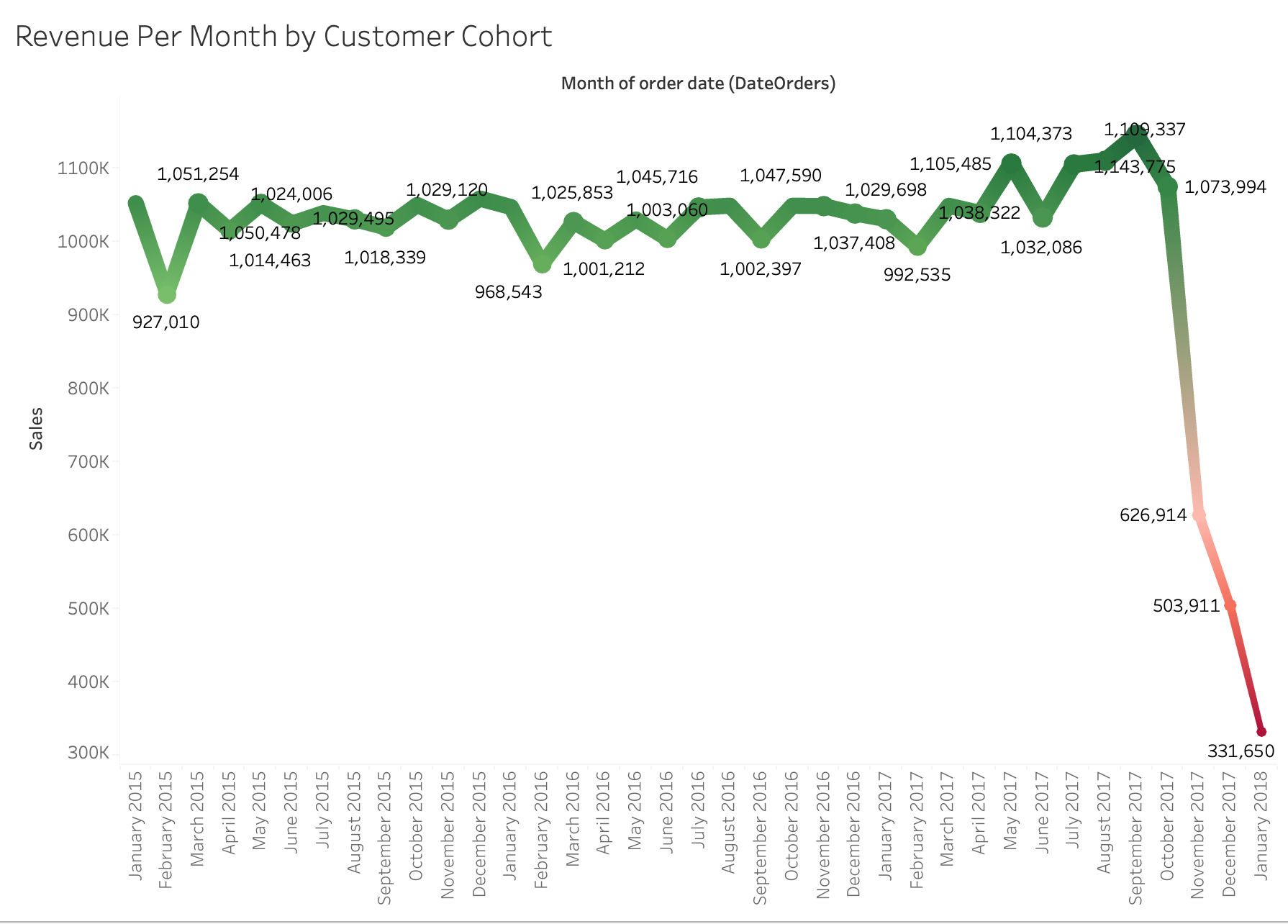
Developers Institute | Final Project
January, 2025
PERFORMANCE METRICS OVERVIEW
Company Performance held steady until recently. We will dive into causes, and insights on why our company took such a hit in late 2017 and provide cost effective strategy to renew performance.

Slide 6
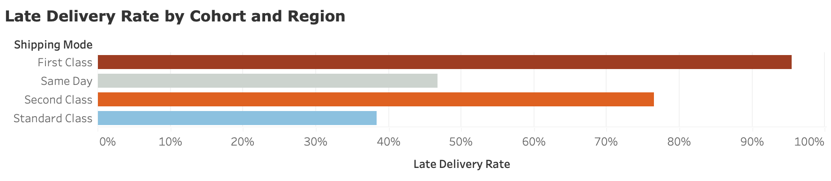
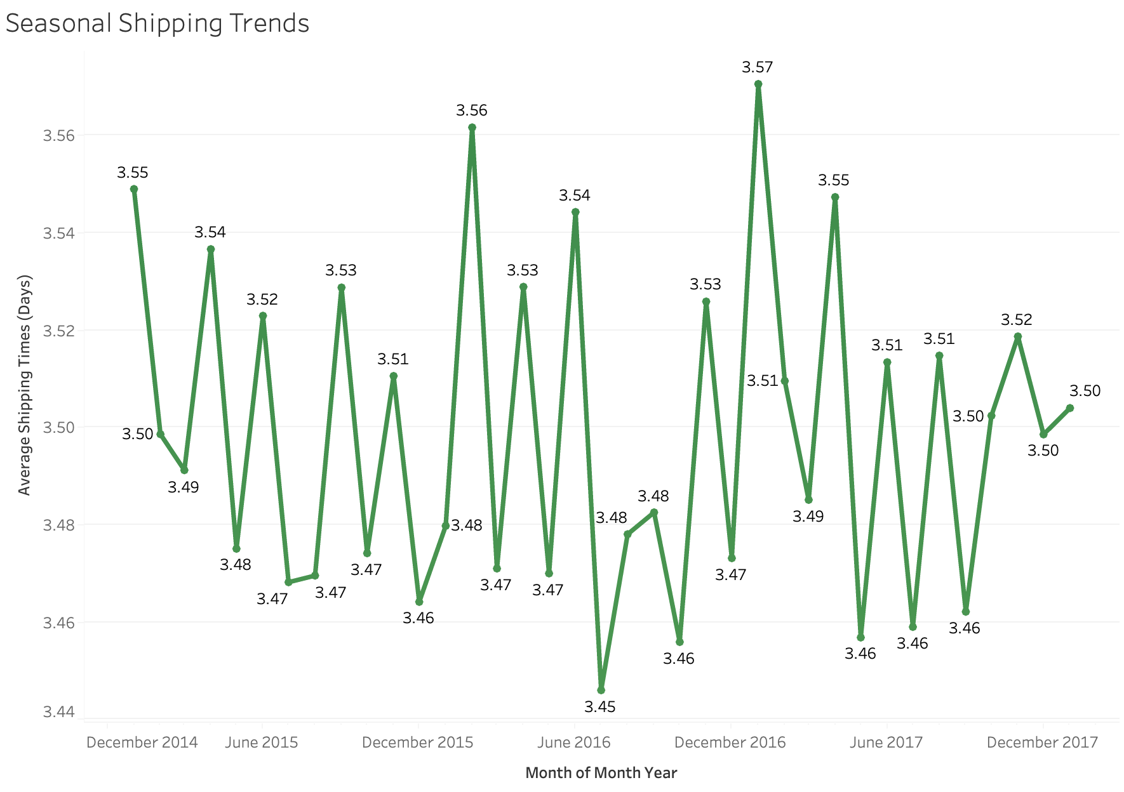
Developers Institute | Final Project
DELIVERY RISK METRICS OVERVIEW
While the numbers appear concerning, the average late time on a delivery is about 0.6 days. First Class delivery improvements are the major concer moving forward. And seasonal shipping trends never exceed an average of 3.5 days to ship.

Slide 7
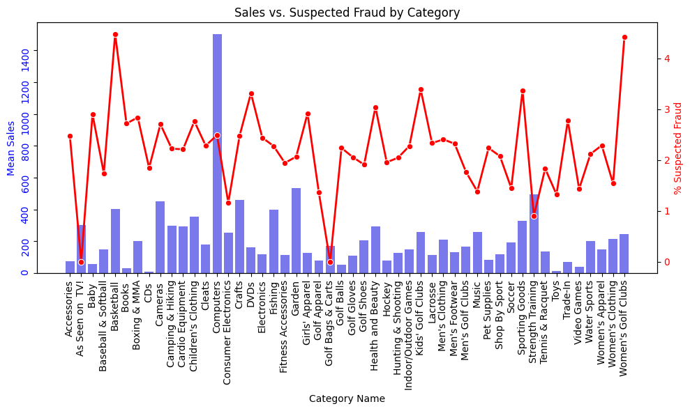
Developers Institute | Final Project
January, 2025
FRAUD METRICS OVERVIEW
Overall, fraud concerns across all categories are majority not significant to overall sales. Max 4% fraud risk in only 2 categories. More on these metrics to follow.

Slide 8

Developers Institute | Final Project
Customer Segmentation Insights
January, 2025
Consumer Cohort
- Consumer segment shows fluctuating sales with occasional spikes - Price trends are stable with occasional price surges. - High customer count correlates with consistent YoY product purchases.
Corporate Cohort
- Consistent sales YoY but peaks less frequently. - Slightly higher average prices, with October 2017 outliers.. - Fewer transactions but larger purchases.
Home Office Cohort
- Lowest sales and customer count. - Niche products with noticeable seasonal trends. - Low customer count and smaller volume purchases.

Slide 9
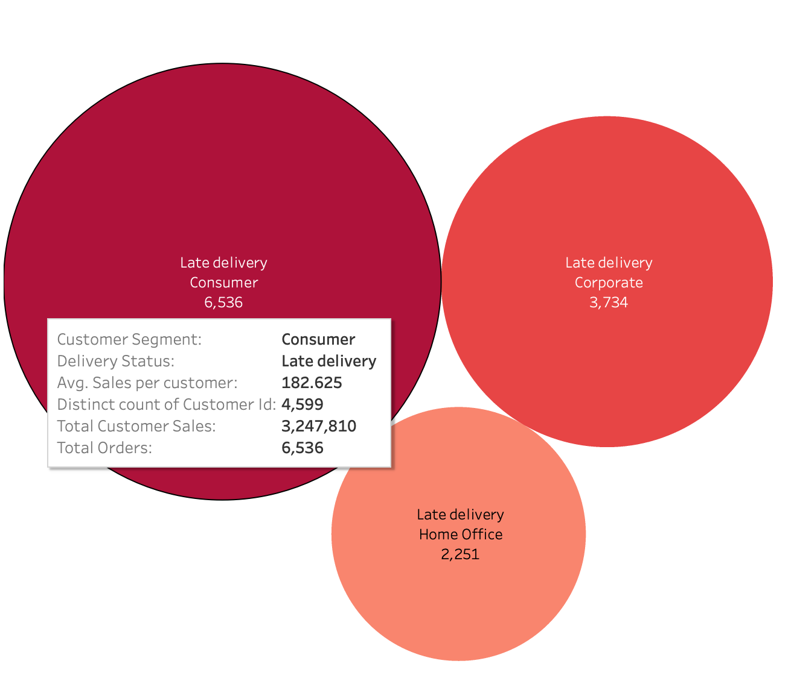
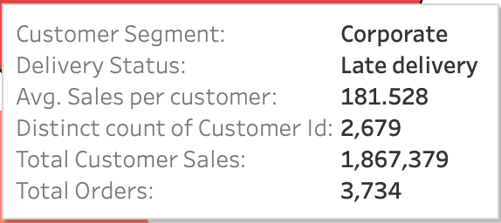
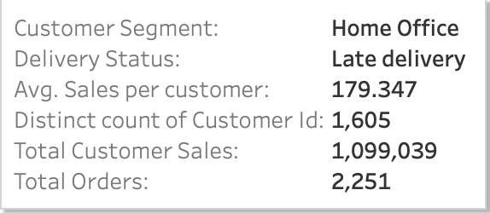
Developers Institute | Final Project
January, 2025
Late
Delivery Risks
- No significant difference in late delivery risk between high and low sales departments.
- Relatively significant difference between scheduled shipping time (avg of 2.9) and real shipping time ( avg 3.5 days)
-True risk percentages range from 54.4% to 58.9% across departments for entire customer base.

Slide 10


Developers Institute | Final Project
January, 2025
Fraud and Risks Analysis
Fraud
Prevalence
Fraud
Prevention
Over 176,000 transactions
flagged as suspected fraud.
No significant difference in average sales per category, but high fraud variance in categories like "Strength Training" and "Golf Shoes."
We ran an initial fraud prediction model:
Logistic Regression: 95.43% accuracy,
strong recall for fraud detection.
Neural Network: 100% accuracy (potential overfitting).

Slide 11

Developers Institute | Final Project
January, 2025
RISK ASSESSMENT
Potential revenue loss and reputational damage due to fraud, especially in high-value categories.
Continuous modeling and testing on new data will ensure robustness and minimize fraud.

Slide 12
Company Name
January, 20XX
Fraud Prevention:
Delivery Optimization
Customer Segmentation
Optimize Logistic Regression for
Real time fraud detection.
Introduce loyalty
programs for
high-spending
Consumer customers.
Use predictive analytics for proactive delivery risk management.
Redesign supply chains for high-priority orders.
Develop targeted marketing campaigns
for each segment.
STRATEGIC INITIATIVES
Conduct regular model evaluation to prevent overfitting.
Make a big impact with professional slides, charts, infographics and more. Turn complex data into easy-to-understand infographics.

Slide 13
Developers Institute | Final Project
January, 2025
Key Performance Indicators (KPIs)
Customer Segmentation
Customer Lifetime Value (CLV)
**Target**: 10% growth year-over-year in each segment.
**Target**: Retention rate of 80%+ for the Corporate and Consumer segments.
**Target**: Increase sales per customer by 15% year-over-year.

Slide 14
Developers Institute | Final Project
January, 2025
Key Performance Indicators (KPIs)
Delivery Optimization
Customer Lifetime Value (CLV)
**Target**: 0.6 day average reduction in delivery time by priority.
**Target**: Reduction to late delivery rate of 25% for the Corporate and Consumer segments across all shipping modes.
**Target**: A 20% increase in sales during slow months (November and December) through targeted promotions.

Slide 15
Developers Institute | Final Project
January, 2025
Key Performance Indicators (KPIs)
Fraud Prevention
Fraud detection
accuracy and recall.
**Target**: >98% detection accuracy.
**Target**: <2% false positives.
**Target**: Precision > 95% and Recall > 90%.

Slide 16

Developers Institute | Final Project
January, 2025
RECOMMENDATIONS FOR IMPROVEMENTS
Start pilot programs for targeted campaigns and delivery adjustments.
Monitor KPIs to evaluate success.

Slide 17
Developers Institute | Final Project
January, 2025
Understand and cater to distinct customer segments.
GOALS REVIEW
Strengthen fraud detection while ensuring minimal false positives.
Optimize delivery for high-priority orders to boost satisfaction.

Slide 18

Developers Institute | Final Project
January, 2025
Q&A and Discussion

Slide 19
Developers Institute | Final Project
January, 2025
CONTACT ME
Connect With Me Today and Let's Start Building Together!
Github
Linkedin

